Slide 1
DS Practicum 2
Presented by: Diya Ganesh, Jasmine McCoy, and Colin Carnish

Slide 2
The Data Science Problem
Develop a predictive model to identify individuals who are at risk of developing diabetes. We do this by working with a dataset that contains various health and demographic features that may help us find patterns between them and diabetes status.

Slide 3
Data Preparation
No null values!
Converting data types from float to integer
No values outside of expected ranges
Some outliers
BMI

Slide 4
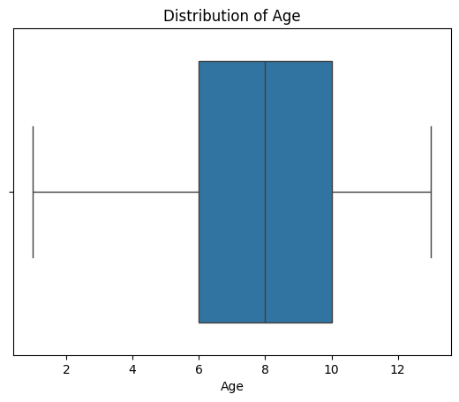
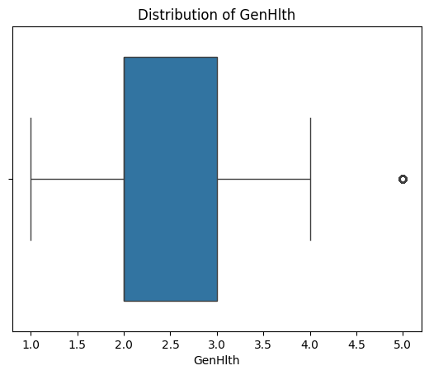
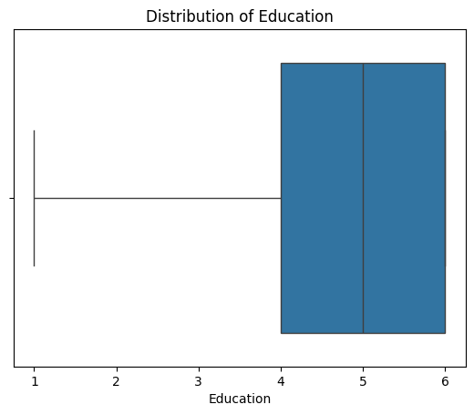
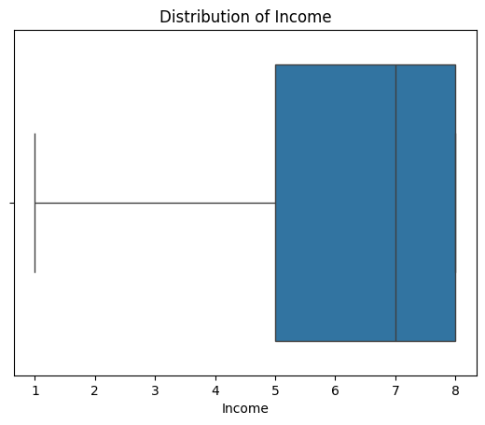
EDA
Box plots to see univariate distribution and outliers of each range column

Slide 5
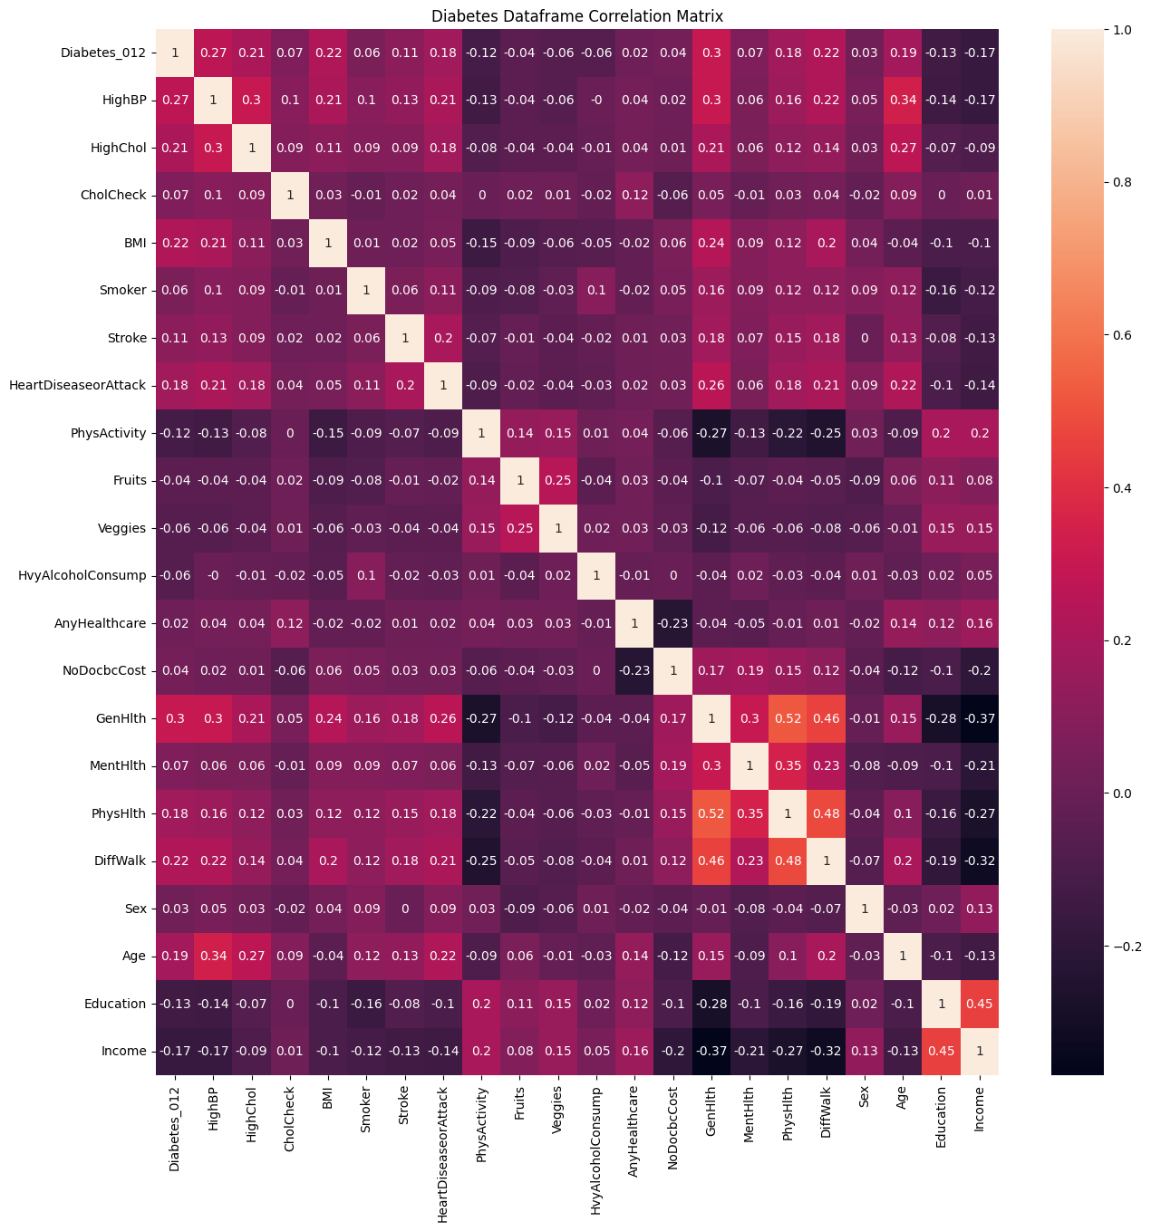
EDA
Box plots to see univariate distribution of each column
Correlation Matrix for bivariate and possible associations

Slide 6
Feature Selection
Of the analysis we've performed, most had very low p-values, which suggested a strong association between the two values. The ones that had higher p-values were Mental Health, if they've had a cholesterol check in the last 5 years, how often they eat fruits and vegetables, if they drink heavily, and if they have healthcare. We did not use those features. Of those we did not check, none of the following should have an effect on diabetes so we were not considering these as features at all: Smoking, NoDocbcCost, Education, and Stroke.

Slide 7
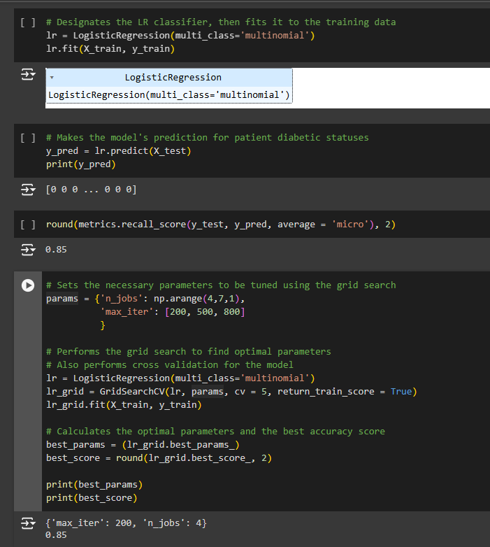
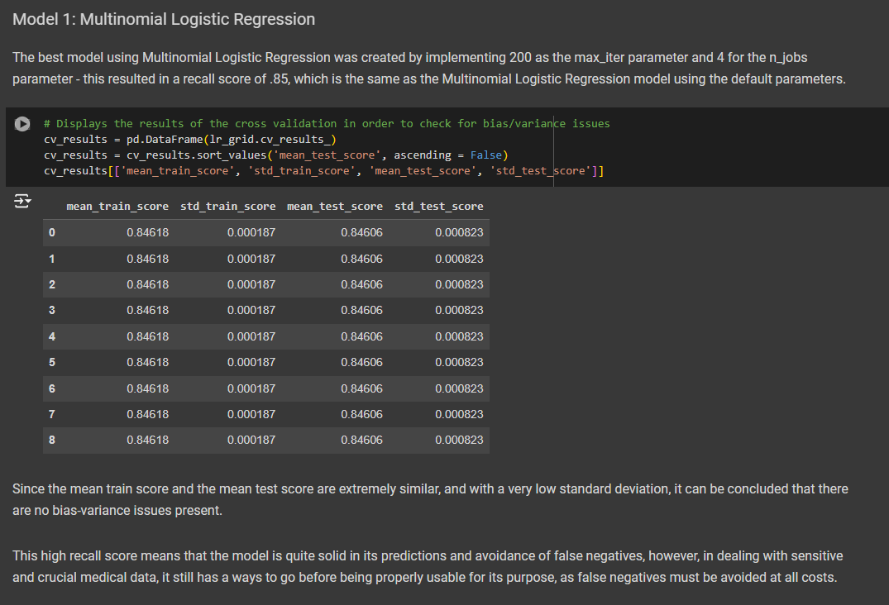
Model Building and Evaluation: Multinomial Logistic Regression

Slide 8
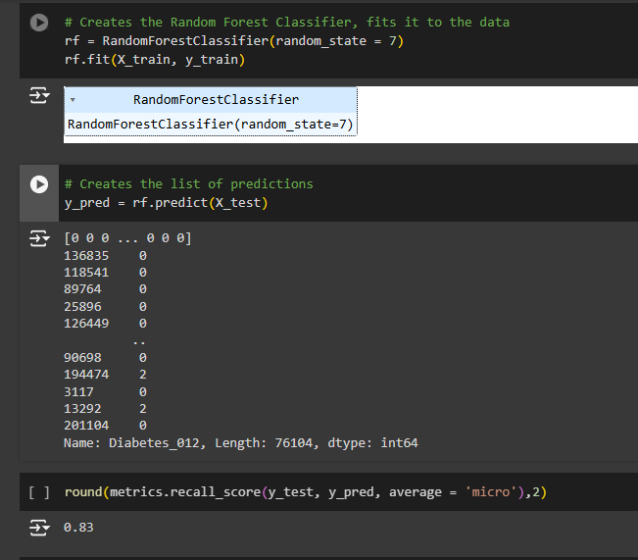
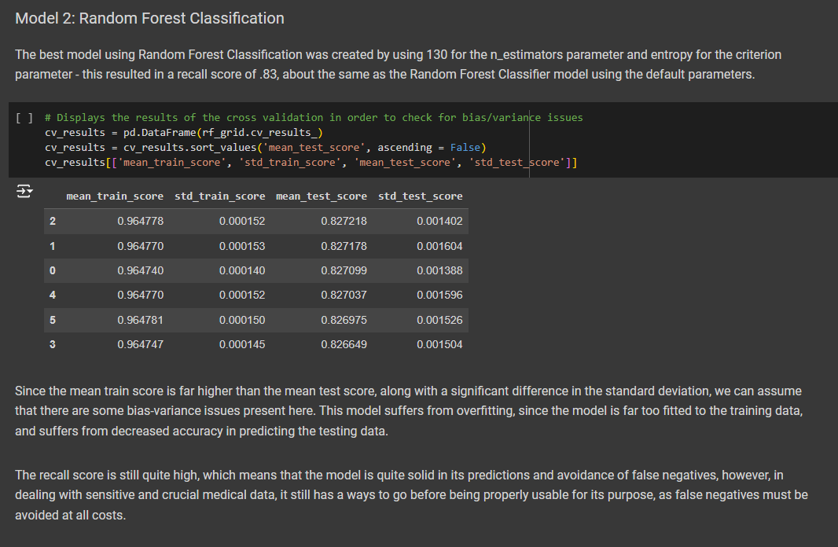
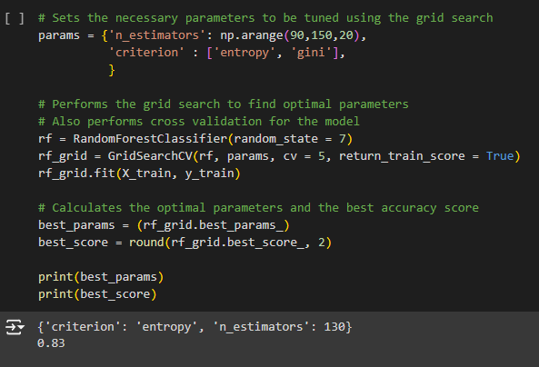
Model Building and Evaluation: Random Forest Classification

Slide 9
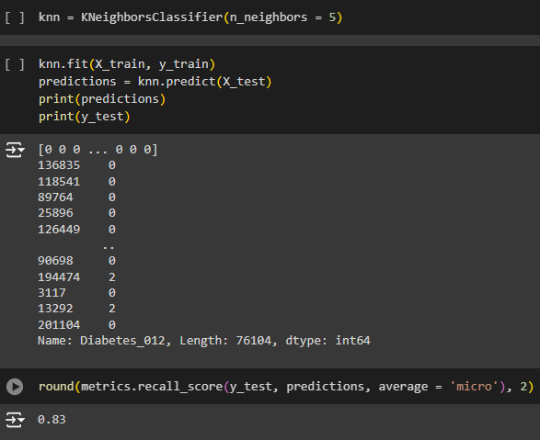
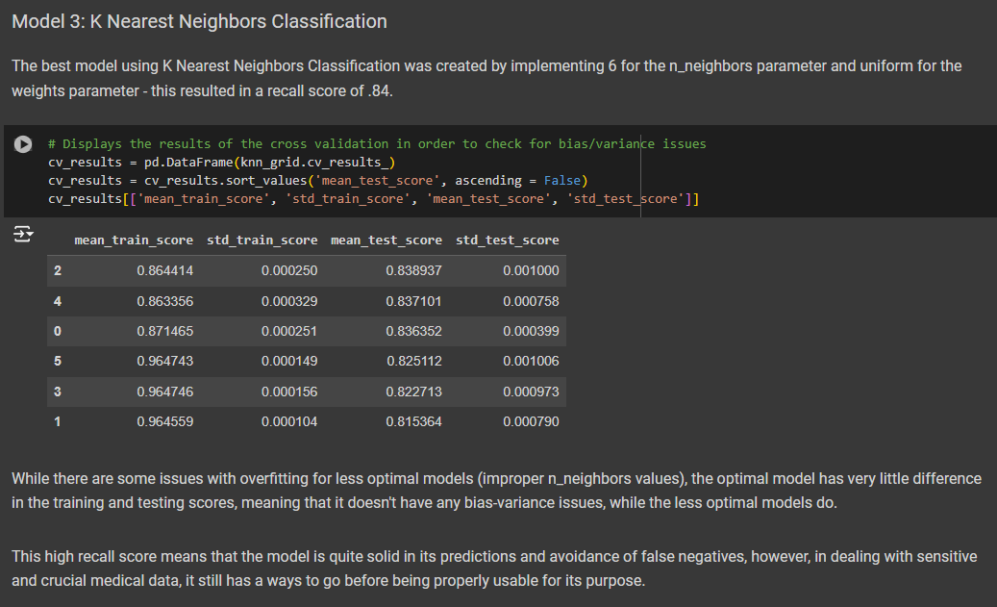
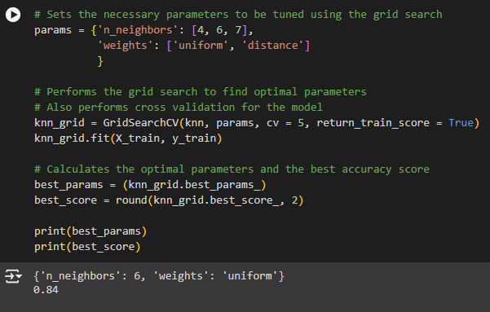
Model Building and Evaluation: K Nearest Neighbors Classification

Slide 10
Overall Findings and Machine Learning Model Results
Multinomial Logistic Regression model performed the best out of the 3
All models had a recall score of around 80-85%
While this is a solid score, since this data is so crucial in its use, the model would need to be improved in order to be properly utilized - false negatives cannot be tolerated

Slide 11
Potential Impacts & Bias
Doctors and healthcare professionals
Patients & their families
Response Bias: Fruits and Veggies
Demographic Bias: Sex and Age

Slide 12
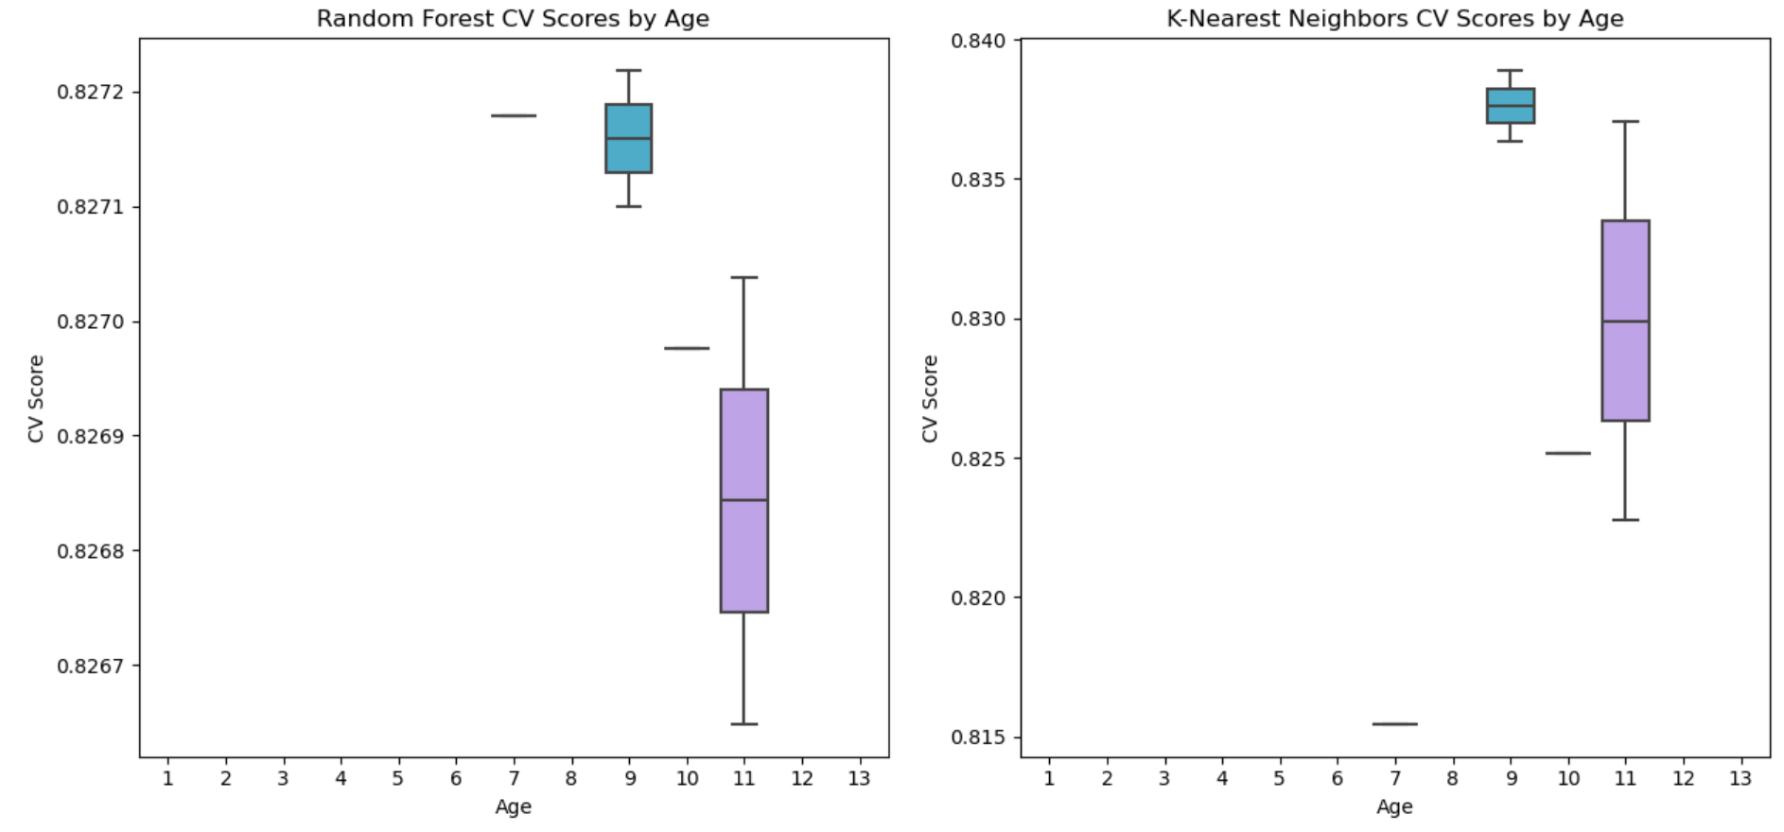
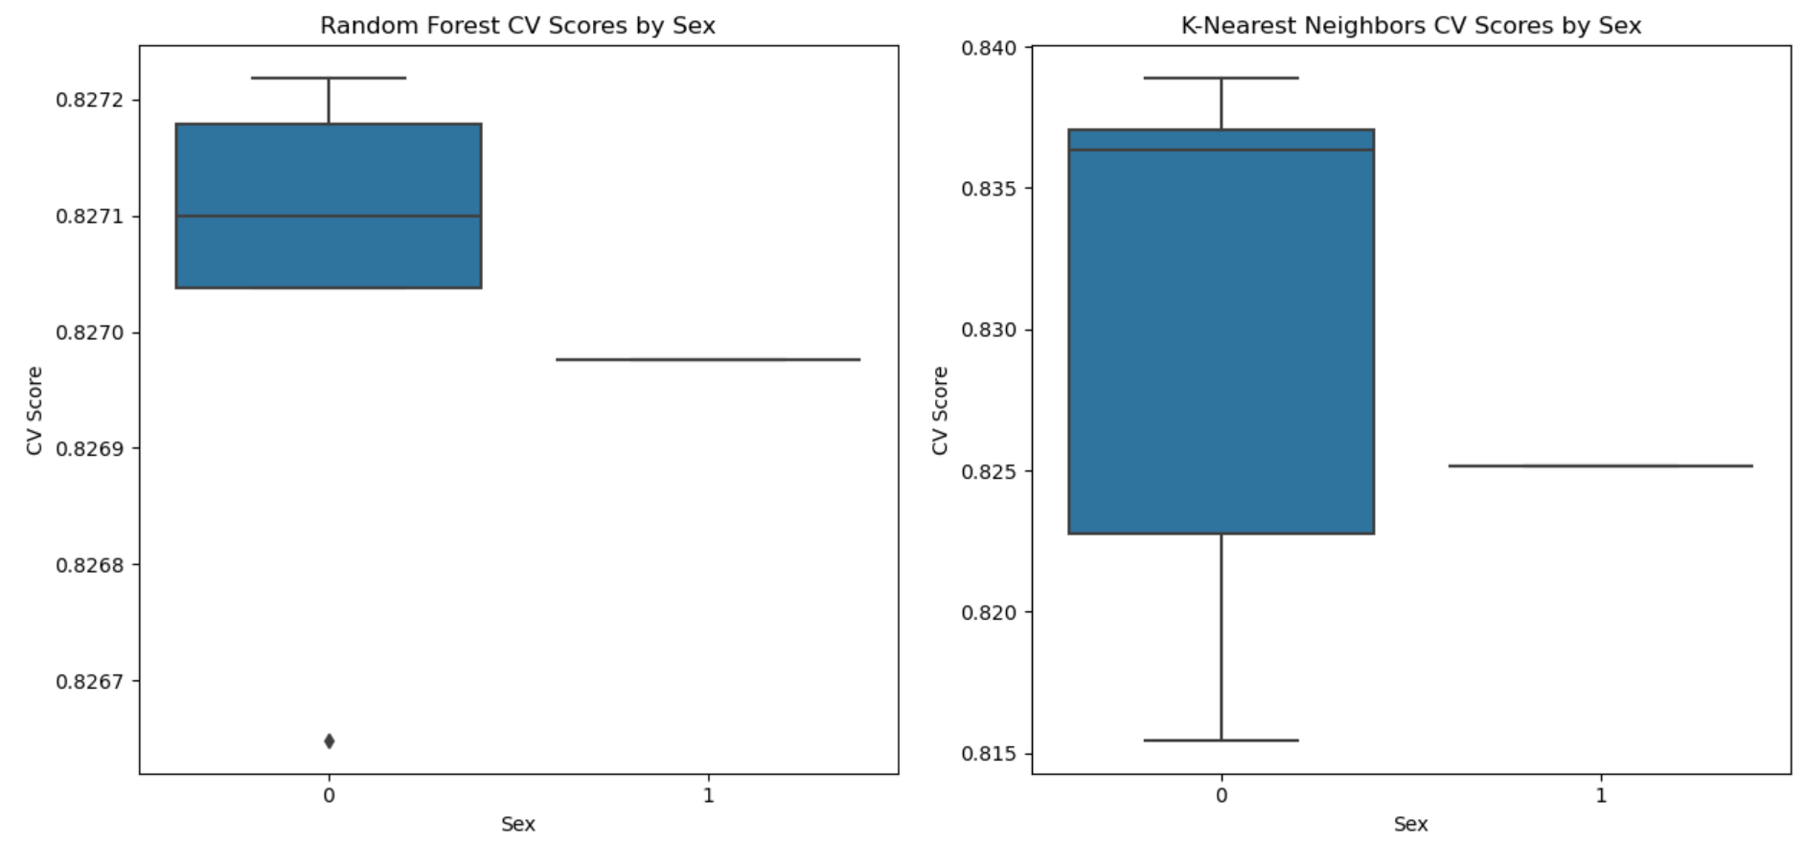
Potential Impacts & Bias

